Slide 1
Testing Agile Vs Traditional
What are differences in roles in these approaches
What specifically is testing role in agile?
https://astqb.org/assets/documents/ISTQB-Foundation-Agile-Syllabus-.pdf

Slide 2
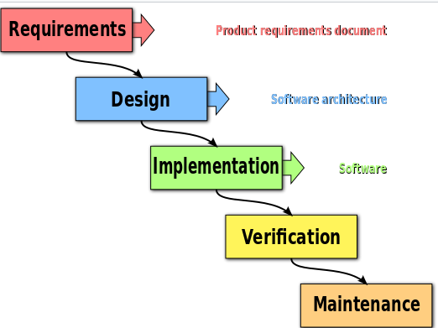
Traditional verification
Testers are involved in requirements to build test plans
Integrate the unit tested code and test it to make sure if it works as expected. 2.erform all the testing activities (Functional and non functional) to make sure that the system meets the requirements. In case of any anomaly, report it. Track your progress on testing through tools like traceability metrics, ALM Report your testing activities.

Slide 3
Agile Vs traditional
Agile:
Very short iterations – each is a working version adding business value
Planning before each iteration – select user stories, then develop and test them
Testing throughout iteration – Not after
Stakeholders might test during iteration
Testers might be part of a paired programming in EP
Testers might be ‘quality/testing’ coaches – supporting team QA
While devs create unit tests -> testers automate and create CI environments

Slide 4
User Stories
Define features small enough to complete in a sprint
Epochs are collection of User Stories
Testers develop light documents
Test plans
Defect reports
Quality right catalogs
Test metrics
In some cases => traceability reports may be prepared to satisfy auditors, regulations, and other requirements.

Slide 5
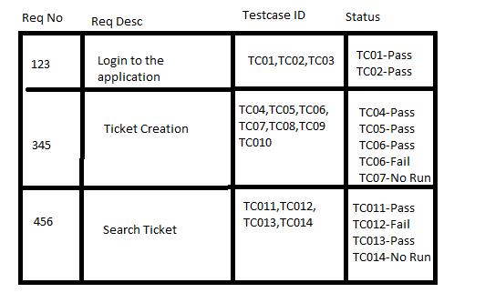
Traceability Matrix
document that maps and traces user requirement with test cases
https://www.guru99.com/traceability-matrix.html
Maps requirements to test to ensure test is complete
Shows test execution status
Highlights missing tests or requirements completion

Slide 6
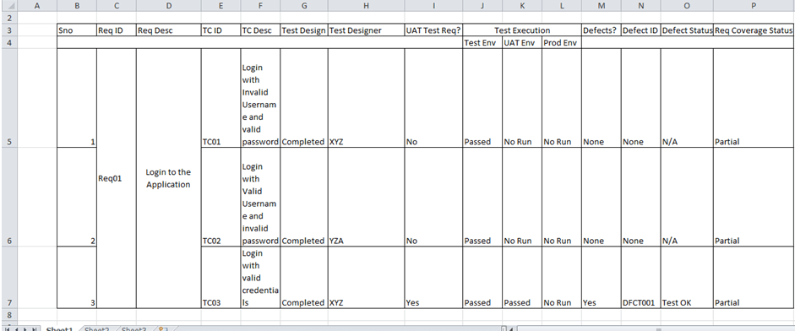
Traceability Matrix
In reality … more completed .. Who is doing it? Different tests run ..defect id

Slide 7
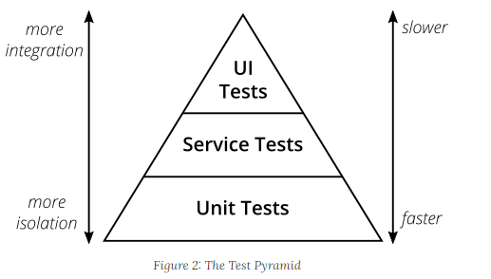
Test Pyramid – what tests to do at different levels
UI testing slow and brittle
Less tests at higher levels
More granule tests here

Slide 8
Testing Role and Agile
May be part of team or separate org
More able to find defects
Independent unbiased
Specialization
Document and automate tests -> rapid feedback
CI – all unit tests run before code checked in.
Cannot check in if failed
Test Data development – create and load and maintain good test data

Slide 9
Agile Tester Skills
Literally finding issues and code problems. Key to keep things positive
Positive Attitude – solution oriented.
Collaborate with team
Quality-orientation – critical thinking about QA issues
Analyze and present status – QA role can provide good assessment of product health
Respond to change, organize work
Might pair program, brain storm bug fixes, help check in process, report and analyze bugs

Slide 10
Agile tester role
Understanding, implementing, and updating the test strategy
Measuring and reporting test coverage across all applicable coverage dimensions
Ensuring proper use of testing tools
Configuring, using, and managing test environments and test data
Reporting defects and working with the team to resolve them
Coaching other team members in relevant aspects of testing
Ensuring the appropriate testing tasks are scheduled during release and iteration planning
Actively collaborating with developers and business stakeholders to clarify requirements, especially in terms of testability, consistency, and completeness
Participating proactively in team retrospectives, suggesting and implementing improvements

Slide 11
Risk Assessment and Testing
Risk assessment -> to identify appropriate amount of testing
W/I Agile – risk assessment at Release Planning and iteration planning
Risk -> the possibility of negative results from event
E.g., slow response rate to UI input, incorrect calculations for bad data, not all input combos tested
Risk analysis process
With team, list backlog items
Identify the quality isks w/ each item
Assess the risk level (hi, me, low)
Estimate testing extent needed
Select a testing technique needed

Slide 12
Risk-based testing - RBT
Testing -> often pressure to get done ASAP and get last minute
- No time (or not possible) to do complete job
Use when –
Time constrainst
Lots of tech challenges (e.g., new DB or hardware)
Lots of project unknowns
Focus on
high impact on business due to failure or high likelihood of failure in the production.
early detection and allowing a team to fix it as early as possible and hence allowing the software/product or feature to ‘Fail Fast’.
bringing value to the customer by increasing the focus on ‘end to end customer experience’.
Tricky Areas -> new hardware or subsystem, tricky logic

Slide 13
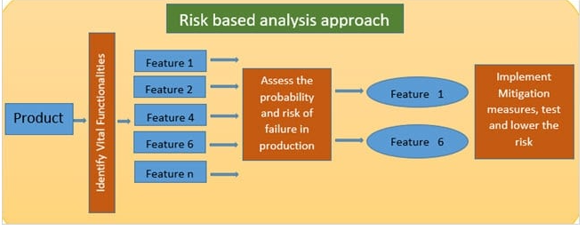
Identify vital function for test
Assess that 1 and 6 are risker
Different shops have different ways to do this process

Slide 14
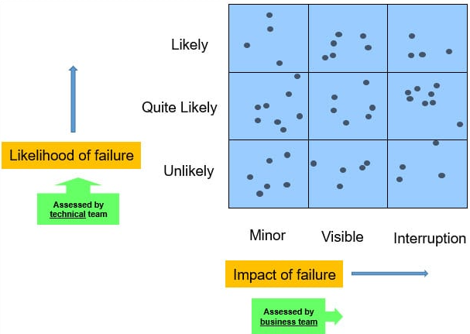
Specifics …
Look at each feature … assess
Likelihood of failure
Impact of failure
Want Likely and Major interruption

Slide 15
Bottom Line
Some agile teams carry testers
Some its part of normal job
Tester role is independent and must collaborate a lot
Test pyramid indicates more tests -> unit and UI test hard to maintain
RBT -> One way to determine which tests to use
High impact, value to customer, tricky areas, early detection

